Slide 1

18ECE340T- MACHINE PERCEPTION WITH COGNITION
UNIT-4
Session-1
Topics Covered: RECOGNITION BY
RELATIONS BETWEEN
TEMPLATES

Slide 2
RECOGNITION BY RELATIONS BETWEEN TEMPLATES
An object may have internal degrees of freedom, Its appearance is highly variable
Example
  people can move arms and legs
  fish deform to swim;
  snakes wriggle
This phenomenon can make template matching extremely difficult
Because one may require either a classifier with a very flexible boundary (and a lot of examples) or many different templates.
In one objects have small components
Example,
Instead of finding a face by looking for a single complete face template, we could find one by looking for eyes, nose and a mouth that all lie in an appropriate configuration.

Slide 3
RECOGNITION BY RELATIONS BETWEEN TEMPLATES
This approach has several possible advantages.
(i) It may be easier to learn an eye template than it is to learn a face template, because the structure could be simpler.
(ii)it may be possible to obtain and use relatively simple probability models.
(iii)Able to match a very large number of objects with a relatively small number of templates.
Animal faces are a good example of this phenomenon —
  all animals with recognisable faces have eyes, nose and a a mouth, but with slightly different spatial layouts.
(iv) simple individual templates can be used to construct complex objects.
people can move their arms and legs around, and it appears to be much more difficult to learn a single,
explicit template for finding whole people than to obtain individual templates for bits of people and a probability model that describes their degrees of freedom.

Slide 4
Finding Objects by Voting on Relations between Templates
Very simple object models can result in quite effective recognition.
The simplest model is object as a collection of image patches .
small image neighbourhoods of characteristic appearance — of several different types, forming an image pattern.
To tell, what pattern is present in an image, find each patch that is present, and allow it to vote for every pattern in which it appears.
The pattern in the image is the one with the most votes. While this strategy is simple, it is quite effective.
Sketch methods for finding patches, and then describe a series of increasingly sophisticated versions of the strategy.

Slide 5
Describing Image Patche
Small image patches can have a quite characteristic appearance, usually when they have many non-zero derivatives (e.g. at corners).
[Schmid and Mohr, 1996] identified- image corners often called interest points.
They then estimate a set of derivatives of the image greylevel at those corners, and evaluate a set of functions of the image derivatives that are invariant to rotation, translation, some scaling, and illumination changes.
These features are called invariant local jets.
Describing these features in detail would take us out of our way. The value of this approach is that, because the combinations are invariant, we expect that they will take the same value on different views of an object.

Slide 6
Describing Image Patches
Assume that the image patches fall into a number of classes.
obtain representatives for each class by having multiple pictures of each object —
corresponding patches will be of the same class, but probably have somewhat different invariant local jets, as a result of image noise.
Determine an appropriate set of classes either by classifying the patches by hand, or by clustering example patches (a somewhat better method!).
Able to tell when two sets of invariant local jets represent the same class of image patch.

Slide 7
Describing Image Patches
Distance between the feature vectors of a patch to be tested If it is below some threshold, the patch being tested is the class .
This is a classifier — it is allocating patches to classes represented by the examples, or deciding not to classify them — and that the patches are templates.
training set that contained rotated and scaled versions of each example patch, under varying illuminant conditions, so the classifier could learn that rotation, scaling and illuminant changes don’t affect the identity of the patch.
The advantage of using invariant features is that the classifier doesn’t need to learn this invariance from the training set.

Slide 8
Voting and a Simple Generative Model
For a given image, find the interest points and classify the image patch at each image point.
constructing a correspondence between image patches and patterns.
Assume that there are Ni patches in the image.
Furthermore, we assume that there is either a single pattern from our collection in the image, or there is no pattern there.
An individual patch could have come either from whatever pattern is present, or from noise.
Patterns typically do not contain every class of patch.
This means that asserting that a particular pattern is present is the same as asserting that some of the image patches came from noise.
only one pattern can be present, and these images patches belong to classes that are not in the current pattern.

Slide 9
Voting and a Simple Generative Model
When a pattern is present, it produces patches of some classes, but not others.
By elaborating Voting and a Simple Generative Model model, obtain a series of algorithms for matching patterns to images.
The simplest version of this model is obtained by assuming that a pattern produces all patches of the classes.
It can produce, and then require that as few patches as possible come from noise. This assumption boils down to voting.
Each image patch, and record a vote for every pattern that is capable of producing that class of patch.
The pattern with the most votes, wins. It say that this pattern is present.

Slide 10
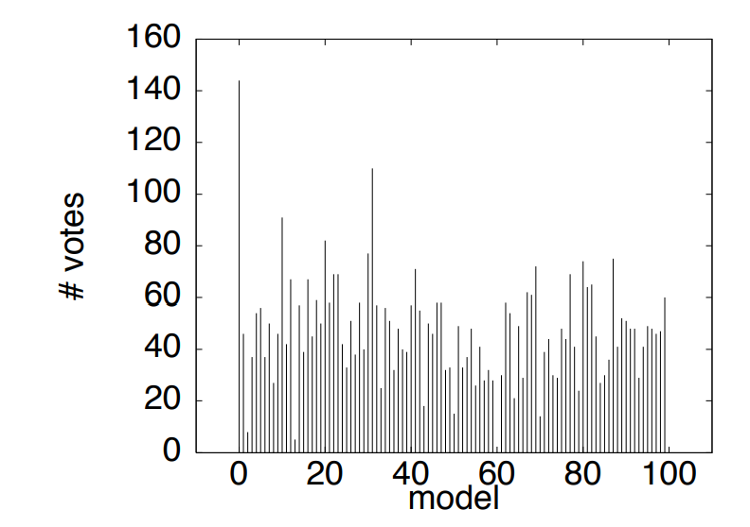
Voting and a Simple Generative Model
When a pattern is present, it produces patches of some classes, but not others.
By elaborating Voting and a Simple Generative Model model, obtain a series of algorithms for matching patterns to images.
The simplest version of this model is obtained by assuming that a pattern produces all patches of the classes.
It can produce, and then require that as few patches as possible come from noise. This assumption boils down to voting.
Each image patch, and record a vote for every pattern that is capable of producing that class of patch.
The pattern with the most votes, wins. It say that this pattern is present.
The graph shows the number of votes for each pattern recorded for a particular image under the simple voting scheme.
Notice that, while the correct match (model # 0) receives the maximum number of votes, three other candidates receives more than half as many votes.

Slide 11
Probabilistic Models for Voting
understand our simple voting process in terms of a probabilistic model.
This is worth doing, because it will cast some light on the strengths and weaknesses of the approach.
Our generative model can be made probabilistic by assuming that the patches are produced independently and at random, assuming that the object is present.
P{patch of type i appears in image|j’th pattern is present} = pij
and
P{patch of type i|no pattern is present} = pix

Slide 12

In the very simplest model, we assume that, for each pattern j, we assume that pij = µ if the pattern can produce this patch and 0 otherwise.
Assume that pix = λ˂ µ for all i.Each observed patch in the image can come from either a single pattern or from noise. There are a total of ni patches in the image.
Under these assumptions, which patches came from a pattern and which from noise to compute a likelihood value.
In particular, The likelihood of the image, given a particular pattern, and assuming that np patches came from that pattern and ni − np patches come from noise, and this value is larger for larger values of np.

Slide 13
Voting on Relations
Geometric relations is to improve on the simple voting strategy fairly easily.
A patch should match to an object only if it there are nearby patches that also match to the object, and are in an appropriate configuration.
The term “appropriate configuration” can be a source of difficulties, but for the moment assume that we are matching objects up to plane rotation, translation and scale (this is a reasonable assumption for such things as frontal faces).
Assume a patch that matches to some object.

Slide 14
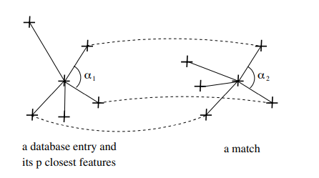
Voting on Relations
Take the p nearest patches, and check
(i) that more than 50% of them match to the same object.
(ii) that the angles between the triples of matching patches are the same as the corresponding angles on the object — these are referred to as semi If these two tests are passed, we register a vote for that object from the patch.
semi local constraints

Slide 15
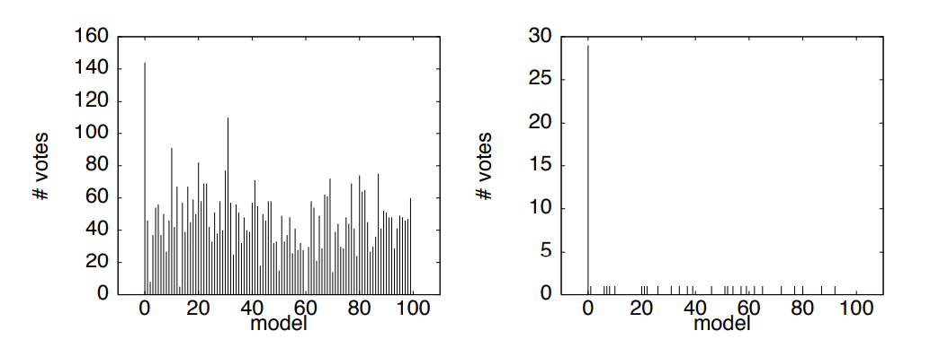
Voting on Relations
In practice, the use of semilocal constraints greatly increases the discriminating power of the original voting scheme.
The figure on the left shows the number of votes recorded for each model under the original voting scheme, for a particular image.
Although the correct match (model # 0) receives the maximum number of votes, three other candidates receives more than half as many votes.
When semilocal constraints are added (right), the correct match stands out much more clearly.

